Slide 1
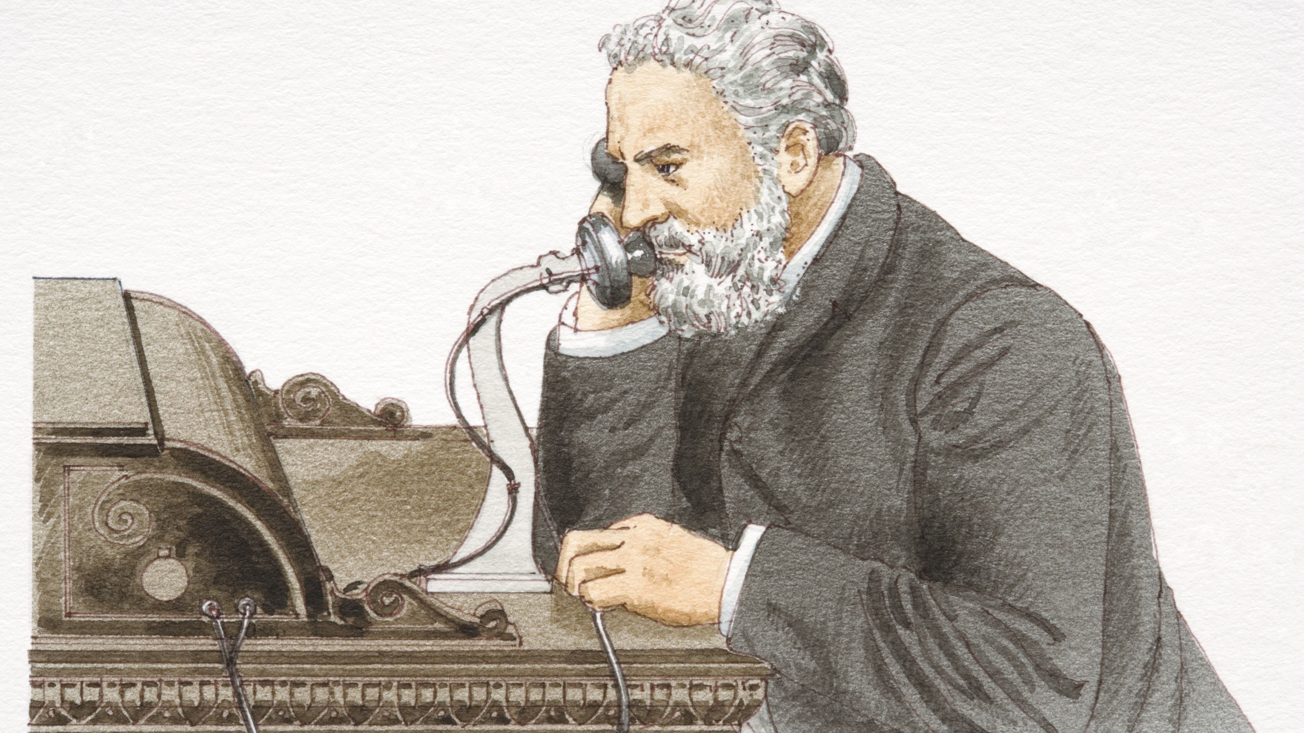
Alexander Graham Bell
By Mohammadreza Badpa

Slide 2

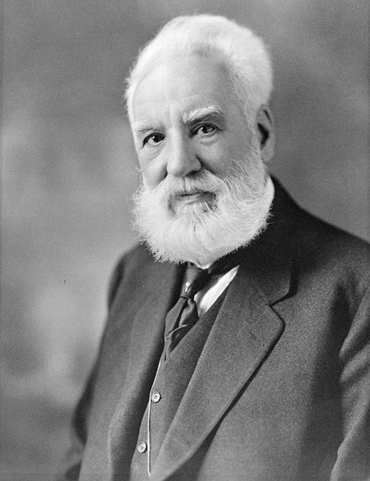
Alexander Graham Bell was a Scottish inventor, scientist, and engineer who is credited with inventing and patenting the first practical telephone. He also co-founded the American Telephone and Telegraph Company in 1885.
Notes:
March 3, 1847 – August 2, 1922 – Scottish

Slide 3

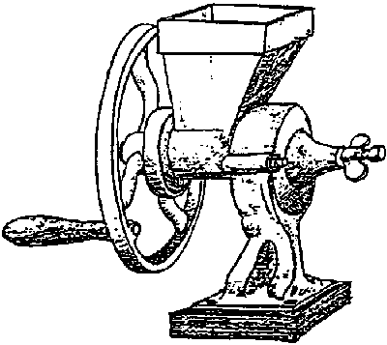
First invention
As a child, young Bell displayed a curiosity about his world. he gathered botanical specimens and ran experiments at an early age. At the age of 12, Bell built a homemade device that combined rotating paddles with sets of nail brushes, creating a simple dehusking machine that was put into operation at the mill and used steadily for a number of years
Notes:
As a child, young Bell displayed a curiosity about his world. he gathered botanical specimens and ran experiments at an early age. His best friend was Ben Herdman, a neighbor whose family operated a flour mill. At the age of 12, Bell built a homemade device that combined rotating paddles with sets of nail brushes, creating a simple dehusking machine that was put into operation at the mill and used steadily for a number of years. In return, Ben's father John Herdman gave both boys the run of a small workshop in which to "invent".

